Slide 1

Find your real estate team

Slide 2
Problems
Customers
Users
Real Estate Agents, Lawyers and Mortgage Brokers want better ways to find and connect with potential clients as current methods are restricting to those entering the market
Home Buyers and Sellers want a more fluid experience with clear access to information, easy to use systems and the ability to match the agent to their needs

Slide 3
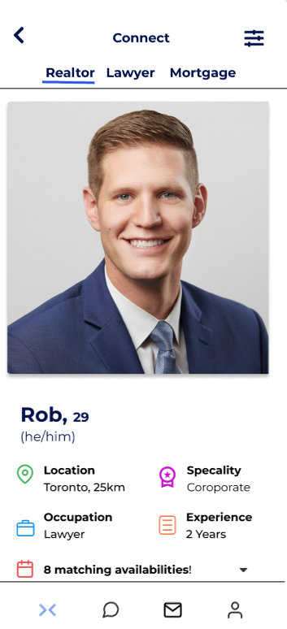
Value Proposition
Cost-Effective method of reaching out
Access to Information
Assist in establishing first point of contact
Convenient and Intuitive application
Higher conversion from lead to client
Organized selection based on user needs

Slide 4


Product - Sign in / Sign up

Slide 5
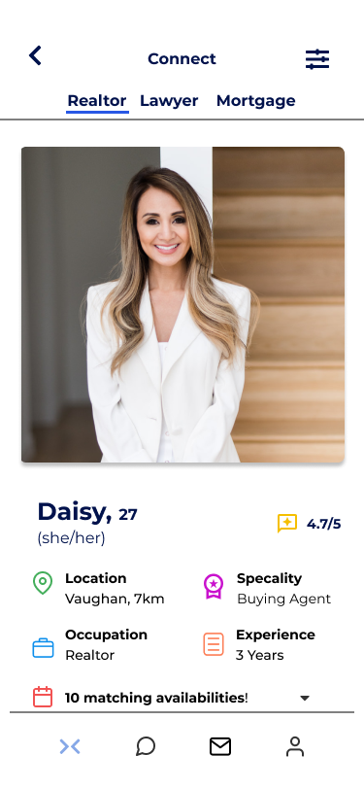
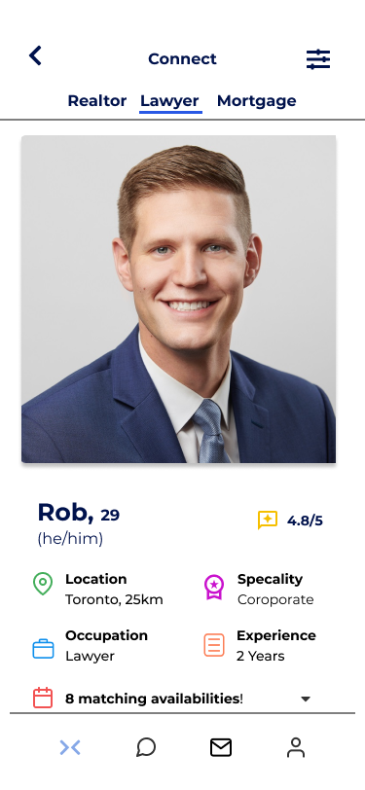
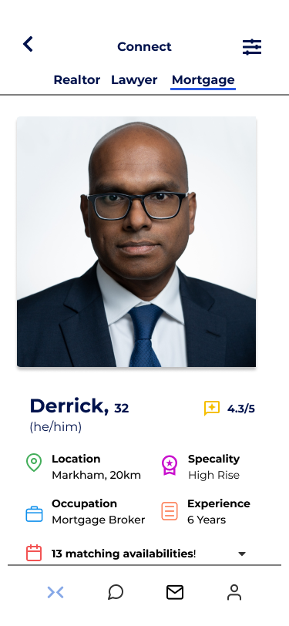
Product - Customer Profile / Matching

Slide 6
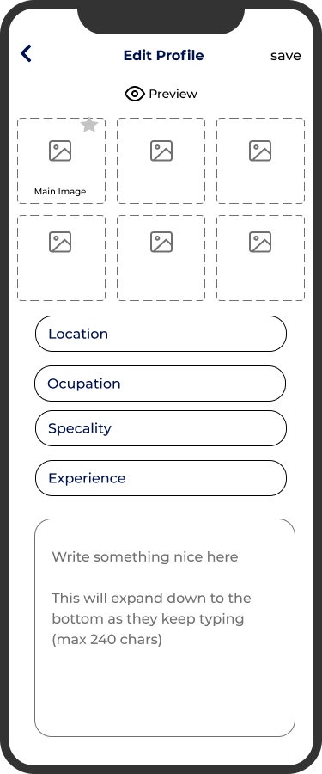
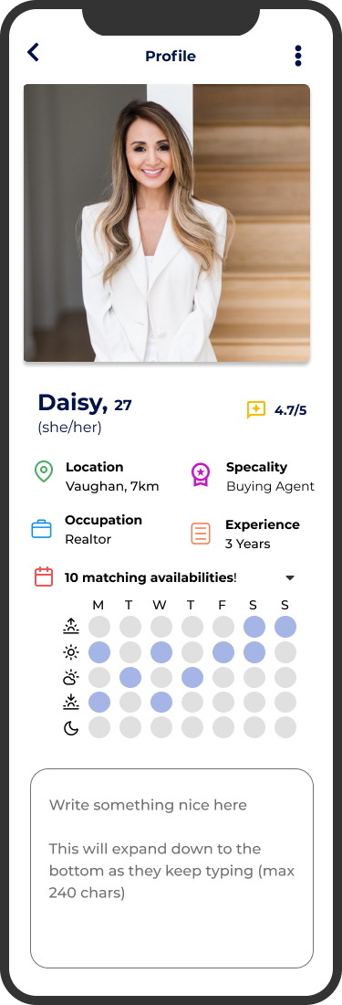
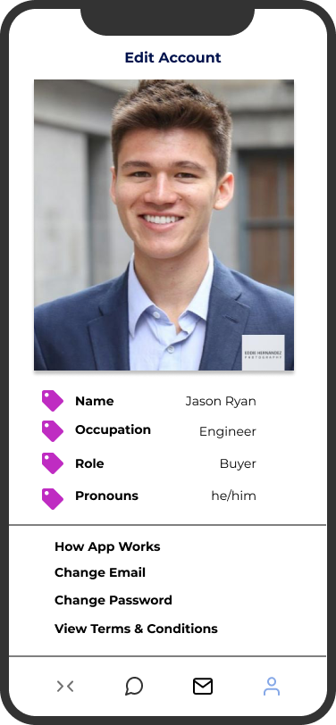
Product - Edit Customer Profile

Slide 7
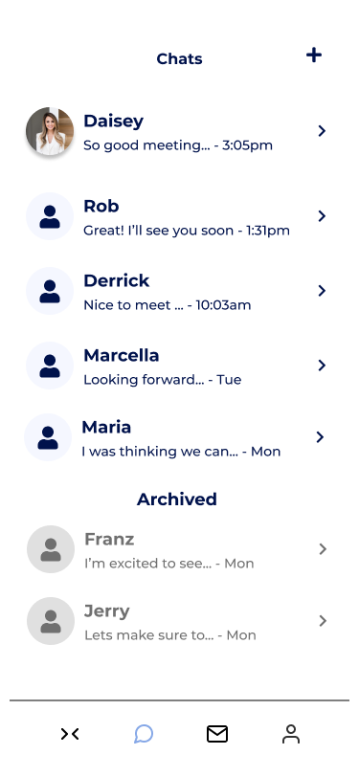
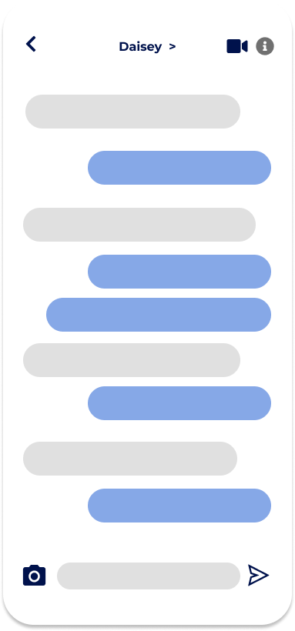
Product - Messaging

Slide 8

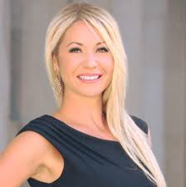
Customer Segmentation
Derrick
Mortgage Broker Age 32
Pain Point:
Struggling to get clients and existing platforms aren’t helping him gain them.
Mary
Real Estate Agent Age 29
Pain Point:
Finding it difficult to generate good leads and must spend lots on marketing to advertise herself.
Demographic:
Age: 19-35
Average real estate agent age is 52 years Old
Puts younger agents with less experience at a disadvantage
Psychographic:
Uses technology to reach customers
Values a cost-efficient way of generating leads

Slide 9

User Base
Pain Point:
Young Working Professional who is struggling to decide on which realtor will best meet his needs
Demographic: Age: 19-35
48% currently own a home in this age Group
50% of home buyers are under the age of 35 in Montreal, and 41% under 35 in Toronto
Psychographic
Values a simple way of comparing realtors, mortgage brokers and lawyers
Believes that they can get the best deal based on the strength of the realtor
Has a busy lifestyle and can't spend too much time looking for an realtor
Feels intimidated by the whole real estate buying process
Jason, 27
Home Buyer

Slide 10



Total Addressable Market
In Ontario
r
Realtors
82,000
Mortgage Brokers
2,749
Real Estate Lawyers
8,300
Notes:
Repmag.ca:
https://www.repmag.ca/news/how-many-real-estate-agents-are-there-in-ontario-334977.aspx
Financial Services Regulatory Authority of Ontario
https://www.fsrao.ca/industry/mortgage-brokering/regulatory-framework/supervision/mortgage-brokering-sector-supervision-plan-2021-22#:~:text=In%20Ontario%2C%20the%20number%20of,1%2C251%20brokerages)%20licensed%20with%20FSRA.
Total Clientele : 93,049
https://www.michaelsfirm.ca/ontario-law-statistical-snapshot/
https://wowa.ca/real-estate-lawyers
10,006,951: User base in Ontario

Slide 11
Business Model
Free Trial
PRO
PREMIUM
Limited Swipes
Access to limited home buyer/seller profile
Some Progression Analytics
Unlimited Swipes
Access to full home buyer/seller profile
Progression Analytics
2 profile boosts per month
Unlimited Swipes
Access to full home buyer/seller profile
Progression Analytics
5 profile boosts per month
Ability to change Geo-Location & Filter Leads
Free for 7 days
$35/mo
$45/mo

Slide 12
CONVENIENCE
BARK
ZOOCASA
REALTOR.CA REMAX.CA
ZOLO
USER
EXP.
BIAS
WORD OF MOUTH
RATEHUB.CA
WOWA.CA
TIKTOK/IG REELS
SEARCH ENGINES
PROVINCIAL DATABASE[RECO, TREB, LAWYERS ONT.]
USER NEEDS

Slide 13
What are the competition missing out on ?
Only tackled small pieces of the problem
Lack of features
Glitchy UI
Too many places to find one thing
No mobile compatibility
Highest paid advertisement showing up first
No reviews
Disconnect between information

Slide 14
Competitive advantage
Giving option to understand how it works
Teaching everything
All in one solution
Trusted source
Dating app style
Ease of use
Notes:
P
Mention social media/ tiktok/reels influencers and how they post and for you page
Google seo
P
Mention social media/ tiktok/reels influencers and how they post and for you page
Google seo

Slide 15

OUR PIVOT

Slide 16
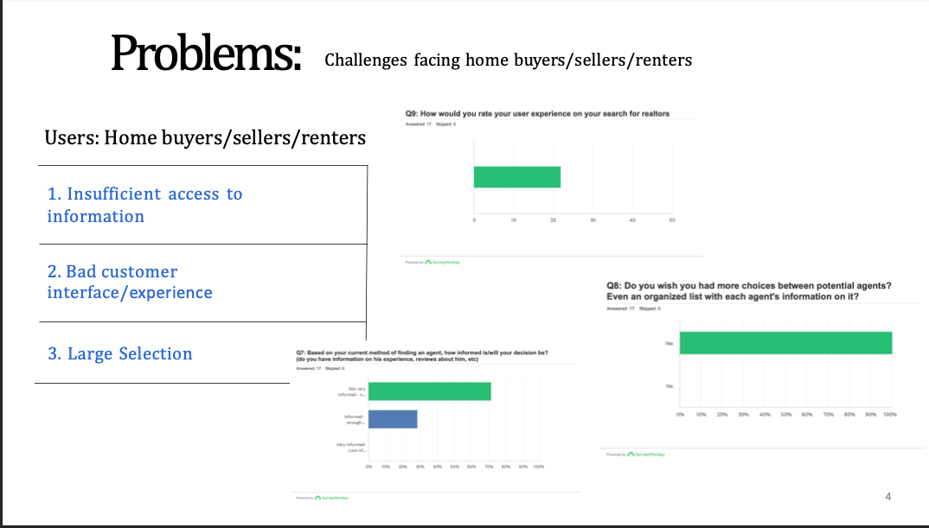
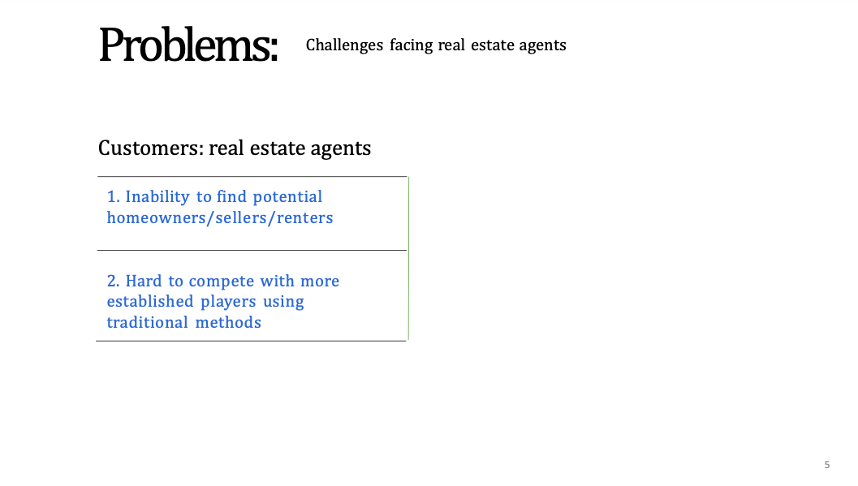
Market Research
Last time we went out and conducted research on the needs of both our user and customer base
Concluded the general issues we theorized
Is our pivot feasible?
Notes:
Prove your pivot here
To maximize profit and increasing the potential customers.
Doing mainly to see if our pivot is feasible
4 realtors
2 real estate lawyers
1 mortgage brokers

Slide 17
Market Research
Pivoted
Is Pivot Feasible?
General Impression and Future Iteration
Interviews / Primary Research
Notes:
General opinion: Everyone found this helpful in this current competitive market. However, one of the realtor who is also mortgage broker brought up that it would be helpful if we can
Solution: when viewing one’s profile they can have commonly works with between the professions. We are planning to make this a premium feature
S: We pivoted our idea
T: We wanted to see if our new idea had some merit
A: We went out and talked to ….
R: General impression was ….. . One thing that was brought up during our interviews was interconnecting the professions within the app.

Slide 18



Channels - Supply Side
Google Marketing
Social Media
Word of Mouth
Notes:
To build the supply side we intend on using Google marketing. This is because Google is the most widely-used search engine. It’s a popular tool for service providers and users to search and follow up on leads. ​
Google Ads require little time and minimum fiscal investment, Targeting the best prospective clients is easy as you narrow in on intent, You can track many metrics using ads etc.

Slide 19

Channels - Demand Side
Social Media
Google Marketing
Billboards
Notes:
We plan on acquiring customers i.e., the users through social media. The target demographic for users on the demand side are in the age group of 25-35 most of them who are tech savvy and avid social media users. ​
For instance, About 47-67% of Instagram users fall in this age range. Targeting ads to these individuals and creating a brand presence on social media can also help bring about brand awareness. ​

Slide 20
Business Timeline
Jan 2022
Dec 2022
Mar 2023+
Concept Development
Beta Release Marketing Begins
Maintenance QA
Apr 2022
FEB 2023
MVP Completed Begin Development
Market Release

Slide 21
Cost Analysis
Total Co-Founders' salary till Market Release (11 months): $ 88,000
• Each Co-Founder will be paid $2,000 per month for 11 months
Total Product Development (11 months): $6,000
Database: $5,575
G Suite: $85
Appstore (Google & Apple): $125
Mailchimp: $185
Domain: $30
Total Marketing (3 months): $44,000
Google ADs: $38,000
FB/IG ADs: $6,000
Total Costs: $138,000
Notes:
But, a $2,000 budget with a $2 CPC gets you 1000 clicks.
$42 CPC for google ads
2000+ 12600 = 14600

Slide 22
Fundraising
May 2022, seeking pre-seed funding: $200,000
• The funding reserves 4 months of additional salary to each co-founder as a backup.
• The extra funding can also be used for unanticipated technology and marketing costs
Notes:
4 months

Slide 23
Revenue Projections (timeline)
Feb 2023
Advertisements and Market Release
Aug 2023
Feb 2024
3k customers
10k customers
$0
$105k
$350k
$35k
$210k
May 2023
Nov 2023
1k customers
6k+ customers
Notes:
The customers are users who have subscribed to our product using base price as $35. We got the above revenue projections

Slide 24

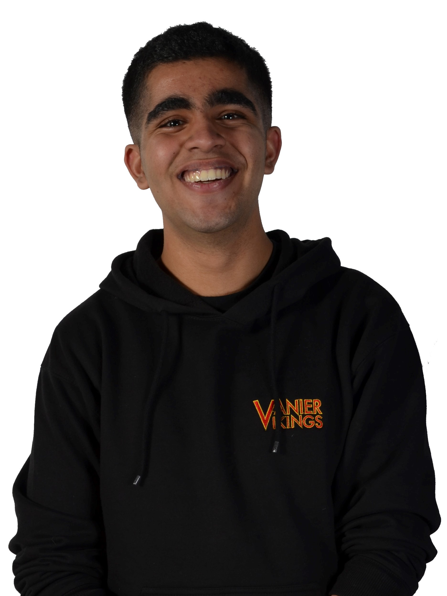

OUR TEAM
Sudhanshu Laroiya
CEO
"The Visionary"
Prithviraj Keswani
CTO
"The Innovator"
Vamsi Lingamaneni
CFO
"The Numeric Mastermind"
Rohit Prabhakaran
CMO
"The Solution Finder"

Slide 25
Thank you
Any Questions?

